Slide 1
529 Data Analytics
October 20, 2016
Lending Club Analysis
Saahil Sofat A20349366 Shravan Polisetty A20347995

Slide 2
Table of Contents
Business Scenario
Business Objective
Selected Data
Analyzing response and predictor variables
Exploratory Analysis
Regression Modeling (PROC GLM)
Regression Modeling (PROC LOGISTIC)
Summary/ Conclusion

Slide 3
Business Scenario: Lending Club
Lending Club is a US based peer to peer company, headquartered in San Francisco, California.
It enables users to obtain loans and investors to purchase notes backed by payments on loans.
Lending Club allows borrowers to take personal loans between $1000 - $40,000.
Each borrower fills an online survey with their personal information and profile features like annual income, loan duration using which a loan grade is assigned to each application.
Every investor has access to check the loan grades and decide to fund an application depending on the loan grade among other features.
A lot of these loans often get “charged off” because of lack of funds or high interest rates. It would be best for both the Lending Club and the investors to be able to find certain predictors which may indicate that the loan may go unpaid. This would help minimize the risk and maximize profit for the organization and investors.

Slide 4
Business Objective:
The objective is to conduct analysis on the data and answer the following questions:
Which variables influence the calculation of the “Interest rate”?
Considering “Term of Loan”, “Credit inquiries in the last 6 months”, “Revolving Utilizations”, “Loan Status”, “Purpose of the Loan”, “Loan Amount”, ”Delinquency Amount” as variables given in the applicant’s form.
How much variability can be explained by this set of variables?
What is the probability of a loan being “charged off”? Also come up with a model equation which can be used to calculate the probability of a loan being “Charged off” given the following information of an applicant.
“Grade of the Loan”
“Number of accounts opened in the last 24 months”
“Public recorded bankruptcies”

Slide 5
Selected Data
File Name - loan.sas7bdat
Source of the data - https://www.lendingclub.com/info/download-data.action
Data Dictionary - https://www.lendingclub.com/info/download-data.action
Total no of observations – 421,095
Total no of variables – 111
Time period - 2015

Slide 6
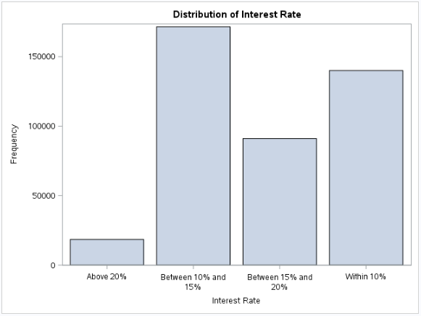
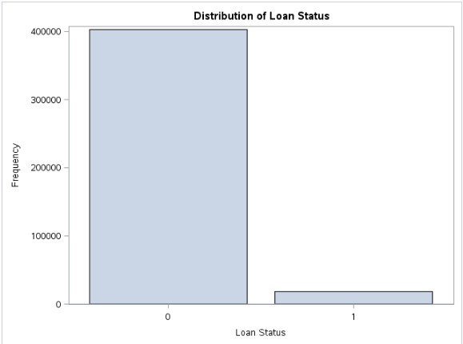
Identifying Variables – Response
“Interest Rate” and “Loan Status” are response variables.
To meet our objectives, we analyze the factors that explain the maximum variability in the interest rate.
“Charged off” loan status means that the applicant is unable to pay back the loan. Our objective is to find the factors that influence the probability of a loan being “charged off”.
Table below shows the description of the response variables:

Slide 7
Identifying Variables – Predictors
Variable | Variable Name | Type | Type Conversion | Scope
Interest Rate on the loan | new_int_rate | Continuous | NO | 5.32 - 29.90
Credit enquiries in the last 6 months | inq_last_6mths | Categorical | YES | 0 - 6
Term of the loan | term | Categorical | NO | 36 months or 60 months
Revolving Utilizations | _new_revol_util | Continuous | YES | 1 (0 - 50)
 |  |  |  | 2(50 - 100)
 |  |  |  | 3(100 - 150)
 |  |  |  | 4(>150)
Loan Status | loan_status | Categorical | NO | Charged of
 |  |  |  | Current
 |  |  |  | Default
 |  |  |  | Fully Paid
 |  |  |  | In Grace Period
 |  |  |  | Late(16 - 30 days)
 |  |  |  | Late(31 - 120 days)
Purpose of the loan | purpose | Categorical | NO | Car, Credit Card, Dept_consolidation, Educational, Home_improvement, House, Major_purchase, medical, moving, small_business, vacation, wedding, other
Loan Amount | loan_amnt_new | Continuous | YES | 1($0 - $10,000)
 |  |  |  | 2($10,000 - $20,000)
 |  |  |  | 3($20,000 - $30,000)
 |  |  |  | 4(>$30,000)
Delinquency Amount | new_delinq_amnt | Continuous | YES | 1($0)
 |  |  |  | 2(>$0)
Number of Accounts open in the last 24 months | acc_open_past_24mths | Continuous | NO | 0 - 64
Number of public record bankruptcies | pub_rec_bankruptcies | Continuous | NO | 0 - 11
Grade of Loan | Grade | Categorical | NO | A - G

Slide 8


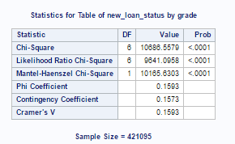
Exploratory Analysis – Eliminating Variables
To remove redundant attributes having the same influence on the response variable, PROC FACTOR is used to find correlations between these attributes.
“Loan Amount” and “Funded Amount” have 0.99142 correlation with each other, hence one of these can be considered as a redundant attribute.
Similarly, “Credit inquiries in the last 6 months” and “Credit inquiries in the last 12 months” also have a high correlation and only one attribute is enough for analysis.
To check weather “Grade” has any relation with “Loan Status”, a PROC FREQ with Chi Square was used.
The test disproves the null hypothesis as P <0.05, and the Chi Square value is high (10686.5579) suggesting that “Grade” can help explain “Loan Status”.

Slide 9
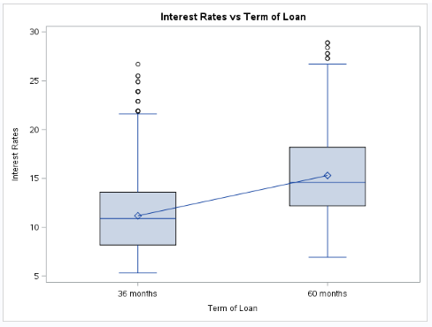
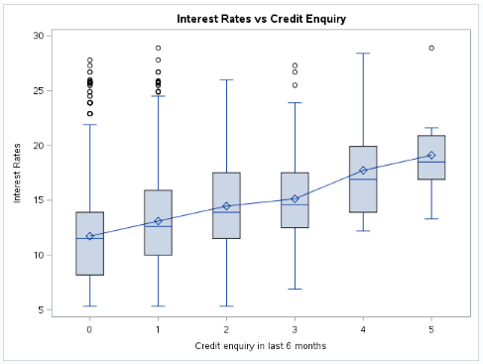
Exploratory Analysis – Loan Term & Credit Inquiry
The plots above show change in “Interest Rate” with respect to the change in “Term of Loan” and “Credit inquiry in last 6 months”.
As the means do not align for both attributes, it explains variability in “Interest Rate”.
This suggest that both attributes can help estimate “Interest Rate”.

Slide 10
Exploratory Analysis – Techniques Used
We are running two regression models, both for a categorical response variable and a continuous response variable.
PROC GLM
Response Variable - Interest Rate
Predictor Variables - “Term of Loan”, “Credit inquiries in the last 6 months”, “Revolving Utilizations”, “Loan Status”, “Purpose of the Loan”, “Loan Amount” and ”Delinquency Amount”.
PROC LOGISTIC
Response Variable - Loan Status (Charged Off vs Not Charged Off)
Predictor Variables – “Grade of the Loan”, “Number of accounts opened in the last 24 months” and “Public recorded bankruptcies”.

Slide 11
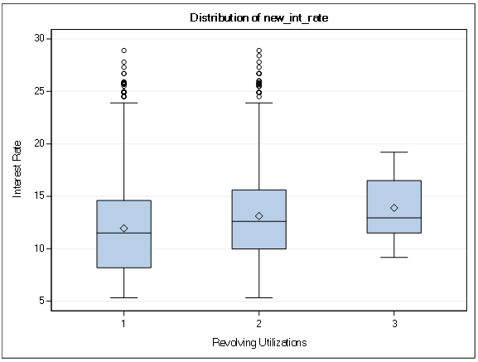
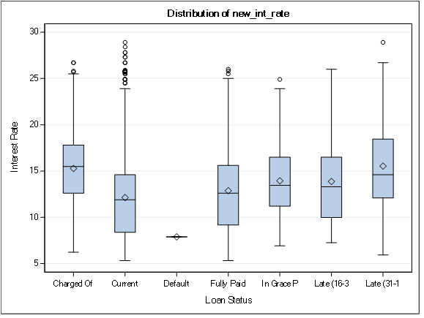
Regression Modeling Results: (Objective-1) PROC GLM – 1 (Revolving Utilizations, Loan Status)
The increase in the number of “Revolving Utilizations” is proportional to the gradual increase in the “Interest Rate”.
The regression model below shows us that, the “Loan Status” also shows variability in the “Interest Rate”. Each status in “Loan Status” has a mean interest rate that is not the same for other status. It is seen that the interest rates for loans that are “charged off” and “Late” have a high “Interest Rate” compared to the other status’s.

Slide 12
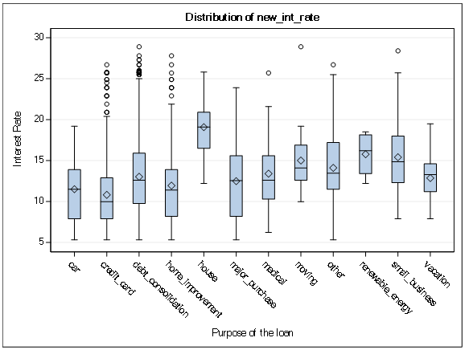
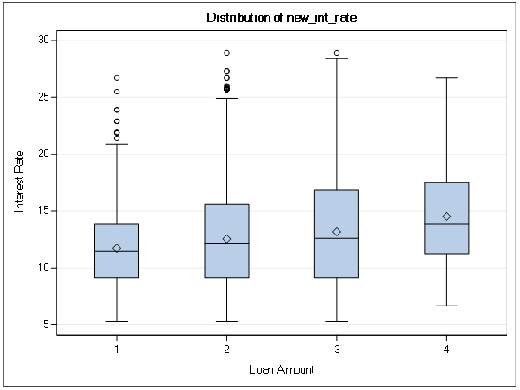
Regression Modeling Results: (Objective-1) PROC GLM – 2 (Purpose of Loan, Loan Amount)
The increase in the “Loan Amount” is directly proportional to the gradual increase in the ”Interest Rate”.
The regression model below shows us that, the “Purpose of loan” also causes variability in the “Interest Rate”. Each purpose has a mean of interest rate that is different for other purposes. The home interest rates are the highest at ~18.5% and the “Interest Rate” for credit cards is the lowest at ~10%.

Slide 13
Regression Modeling Results: (Objective-1) PROC GLM - 3
The increase in the number of “Credit enquiries in the last 6 months” is directly proportional to the increase in the “Interest Rate”.
Similarly, a longer “Term of loan” i.e 60 months has a higher “Interest Rate”.
GLM Regression is used to find and plot the influence between “Interest Rate” and predictor variables.
The goal is to find a set of variables which have high influence in the variability of the “Interest Rate”, individually and combined.
Attribute Name | R² value
Credit enquiries in the last 6 months | 0.055235
Term of the loan | 0.195318
Revolving Utilizations | 0.019491
Loan Status | 0.037337
Purpose of the loan | 0.05511
Loan Amount | 0.040754
Delinquency Amount | 0.000561
The table above gives the description of the individual attributes taken into consideration and their respective individual variabilities of the interest rate.
It is noticed that apart from the term of the loan, all of the other attributes do not have high influence in the variability of the interest rate.

Slide 14
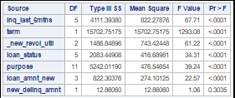

Regression Modeling Results: (Objective-1) PROC GLM – Final Results
The table below shows that all attributes disprove the null hypothesis (Pr>0.05).
Collectively they explain 37% variability on the interest rate.
This variability is very high considering the fact that the internal workings of calculating a credit score and Interest rates are not transparent.

Slide 15
Regression Modeling Results: (Objective-2) PROC LOGISTIC
The response variable “Loan Status” is either “charged off” or not.
It is a categorical value.
The predictor variables are “Grade”, “Number of publicly recorded bankruptcies” and “Accounts opened in the last 24 months”.
Each predictor is used to model the response separately. This way we find the percentage increase/decrease in the likely hood of the response variable being “charged off” with a unit increase in each predictor.
“Loan Status” contains two values i.e 1=“charged off” and 0=“Not charged off”.
“Grade” contains values from A-G representing the grade assigned by the lending company to the loan in decrementing order.
“Number of publicly recorded bankruptcies” is a continuous variable.
“Accounts opened in the last 24 months” is a continuous variable.

Slide 16
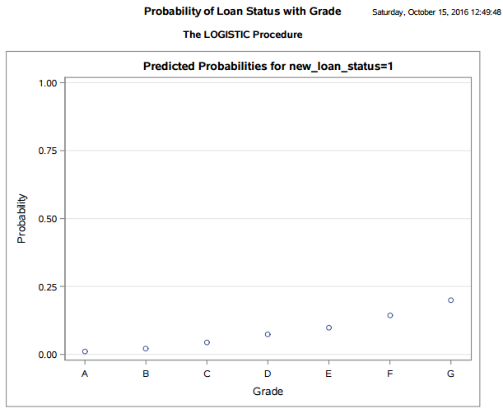
Regression Modeling Results: (Objective-2) PROC LOGISTIC-2 (Loan Status vs Grade)
This chart represents probability of the loan being “charged off” with an increase in the Grade of loan.
As the Grade of the loan increases there is an increase in the probability of the loan being “charged off”.
There is a ~25% chance of the loan being “charged off” if the grade is G and ~0% if the grade is A.

Slide 17
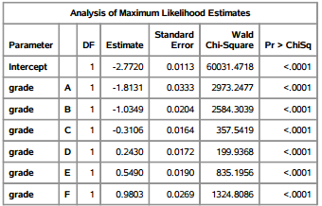
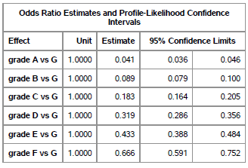
Regression Modeling Results: (Objective-2) PROC LOGISTIC-3 (Loan Status vs Grade)
This table renders the Intercept values for each Loan Grade, from which the model equation can be formed.
Logit() = -2.77-1.81*A-1.03*B-0.31*C+0.24*D+0.54*E+0.98*F. This logistic regression equation is used to calculate the likely hood of a loan being “charged off” .
The table below shows the odds of a loan being charged offfgiven each grade.

Slide 18
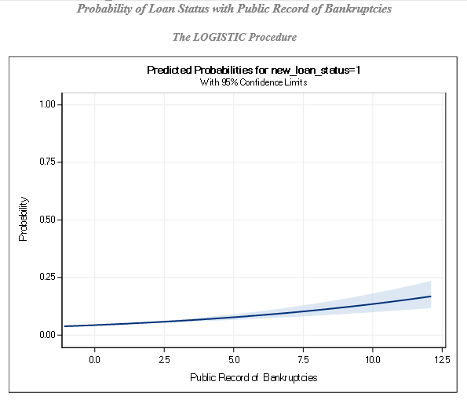
Regression Modeling Results: (Objective-2) PROC LOGISTIC-4 (Loan Status vs Bankruptcies Count)
This chart represents probability of the loan being “charged off” with an increase in the “Number of public record of Bankruptcies”.
As the Count increases there is an increase in the probability of the loan being “charged off”.

Slide 19
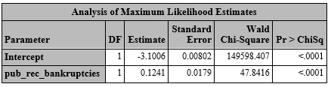
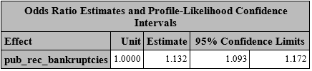
Regression Modeling Results: (Objective-2) PROC LOGISTIC-5 (Loan Status vs Bankruptcies Count)
This table renders the Intercept values for Public record of Bankruptcies Count, from which the model equation can be formed.
The logistic regression equation to calculate the likely hood of a loan being “charged off”- Logit() = -3.1006 + 0.124 * No. of Bankruptcies.
This equation can be used to predict if a loan may end up “charged off” depending on the “Number of past bankruptcies”.
The ChiSq values for the “Public record of bankruptcies” are within the confidence levels and the Pr<0.05 which disproves the Null Hypothesis.
The table above shows the odds of a loan being “charged off” given the “Record of bankruptcies”.

Slide 20
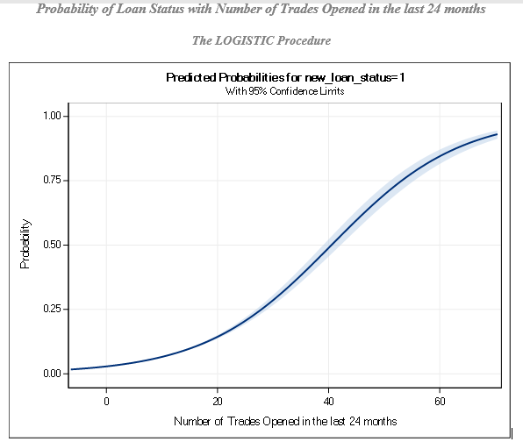
Regression Modeling Results: (Objective-2) PROC LOGISTIC-6 (Loan Status vs Accounts Number)
This chart represents probability of the loan being “charged off” with an increase in the “Number of accounts opened in the last 24 months”.
As the number of the accounts opened increases there is an increase in the probability of the loan being “charged off”.

Slide 21
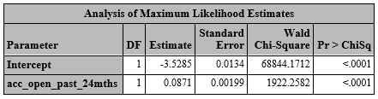

Regression Modeling Results: (Objective-2) PROC LOGISTIC-7 (Loan Status vs Accounts Number)
This table renders the Intercept values for “Number of accounts opened in the last 24 months”, from which the model equation can be formed.
The logistic regression equation to calculate the likely hood of a loan being “charged off”- Logit() = -3.52 + 0.087 * No. of Accounts Opened.
This equation can be used to predict if a loan may end up “charged off” depending on the “Number of accounts opened”.
The ChiSq values for the “Number of accounts open within the past 24 months”, are within the confidence levels and Pr<0.05 which disproves the Null Hypothesis.
The table above shows the odds of a loan being “charged off” given the “Annual income”.

Slide 22
Summary/Conclusion
Objective 1 Summary:
From the analysis conducted, we can conclude that credit inquiries in the last 6 months, term of the loan, loan status, purpose of the loan, loan amount and the delinquency amount have a high influence on the interest rate.
Using PROC GLM with the collection of these variables, we were able to explain 37% variability in the interest rate.
Individually, these variables have little or no influence in the variability in the interest rate.
Objective 2 Summary:
Using PROC LOGISTIC it is concluded that the probability of the loan being “charged off” given:
The Grade of the loan is
Logit() = -2.77-1.81*A-1.03*B-0.31*C+0.24*D+0.54*E+0.98*F.
The Public record of bankruptcies is
Logit() = -3.1006 + 0.124 * No. of Bankruptcies.
No. of Accounts Opened is
Logit() = -3.52 + 0.087 * No. of Accounts Opened.

